Slide 1

Bahir-Dar University Bahir-Dar Institute of Technology Faculty of computing Department of computer Science Requirement design document (RDD) Title: Android Based Taxi Booking And Ordering System by Abraham Tilahun Bahriw Amare Abdurohman Abtew Nebil Nuredin Advisor: Mrs. Mieraf K. and Rahel M. June, 2013 E.C

Slide 2
Outlines
Introduction
Statement of the problem
Objective
Methodology
Feasibility studies
Significant of the project
Limitation of the project
Scope of the project
Existing system
Proposed system
System design

Slide 3
Chapter-one Introduction
Taxi services are highly in demand in big, medium and small cities.
Taxi drivers and taxi users waste much time for waiting a taxi or waiting a customer. To get service, a customer needs to wait in the street until drivers come there.
To reduce these wasting time, to be more productive for both drivers and customers, and to use our time wisely, we come up with the project so called “Taxi ordering and booking system.”
In the newly proposed system, customers can book taxi from anywhere in the city at any time and drivers can accept booking request and give quality service to the customers.

Slide 4
Statement of the problem
Taxi users loose their time.
Taxi drivers waste their time and resource by staying somewhere until customers come to get service.
There might be some disagreement and occasional disputes among drivers and customers which comes from service payments.
Customers can not get good, trusted and quality service anytime at anywhere.
Drivers and taxi owners are not well benefited

Slide 5
Objective
General Objectives
The aim of this project is to design, develop and implement an online Taxi booking app to order and book taxi service online by using mobile phone.
Specific objective
To plan the design and development of our system
To develop procedures for appropriate recording of passengers
To develop interactive and user friendly interface so that the user can easily book a taxi in few minutes by doing few clicks.
To Program the functional units of the system

Slide 6
Methodology
Requirement gathering methods
Interviews
Observation and
Through involvement
Analysis and design Methodology:
We decide to use object oriented system analysis and design methodologies due to the following reason:
Simplicity
Reusability
Increased extensibility
Maintainable
Modifiability
Increased Quality

Slide 7
Implementation Methodology
Hardware tools
Personal computer to run the application in administrator side.
Any android device with compatible version
And network devices
Software tools
Visual paradigm: - to Draw User Interface Design
Microsoft PowerPoint:-for presentation.
Microsoft word: -to write our system documentation.
Android studio to write a code

Slide 8
Feasibility Studies
Economic feasibility
Technical feasibility
Time feasibility
Operation feasibility

Slide 9
Significant of the project
The significance of the study is to create android based taxi booking system that will provide quality services to customers.
It has benefits for
Drivers
Customers
And taxi service center
Government

Slide 10
Limitations of the project
The project is faced with the following limitations.
This project is only limited to contract taxi service
Restricted only in Bahir-Dar city.
No online payment method is integrated to the system

Slide 11
Scope of the project
Proposed system focus only on contract taxi in Bahir Dar city on the following areas;
Booking Procedure
Driver Details to the Customer
Customer Details to the Driver
Location Tracking

Slide 12
system features
Existing system description
Customers get taxi service standing on a straight until taxi comes or they may call to drivers from long distance and they may be expected to wait for long time until the taxi reaches.
Major functions
Taxi order
Modify the order-negotiate on the destination and the price
Cancel the order- if they disagree on the negotiation

Slide 13
Requirement analysis
Functional Requirements
Taxi registration
Driver registration
Make booking
Show booking
Report generation
Change status

Slide 14
Non-functional requirements
Efficiency
Usability
Security
Availability
User Interface

Slide 15
Users of the system
Customer
Taxi drivers
Taxi service providing center(Admin)

Slide 16
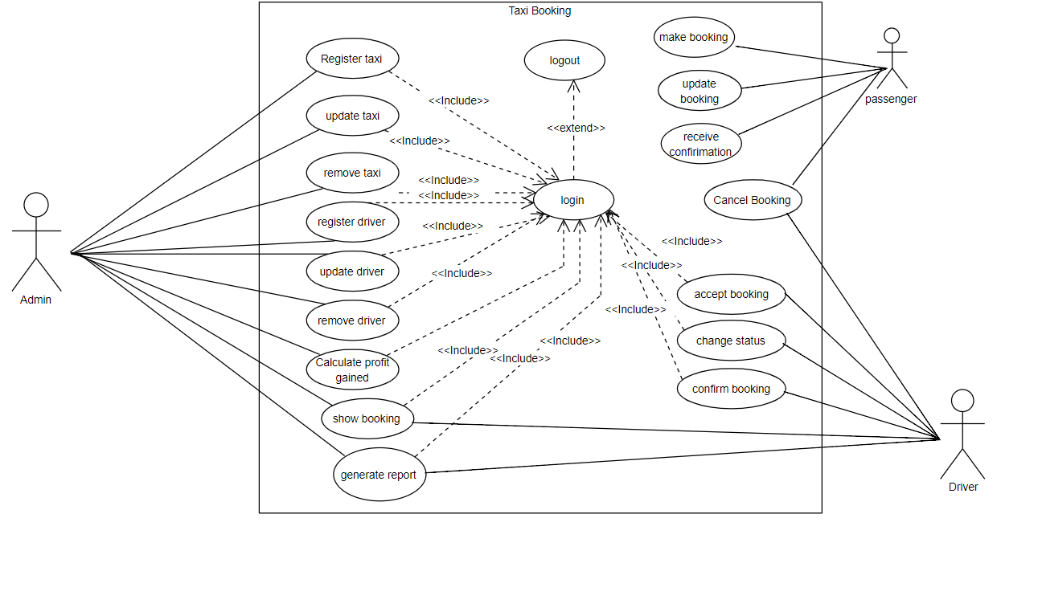
System use case

Slide 17
User interface prototype

Slide 18
Activity diagram for taxi registration
Activity diagram
. It focuses on the flow of activities involved in a single process.
It is UML diagram that indicates the basic flow of activity.

Slide 19
Sequence diagram

Slide 20
Conceptual class model-Analysis level of class diagram
Class diagram is static model that shows the classes and the relationships among classes that remain constant over the time.
Class is the main building block of class diagram, which stores and manages information in the system.
Class diagram will be the building block of our system that we are going to develop.
Class diagrams show the objects the system is comprised of and how they are interrelated.

Slide 21
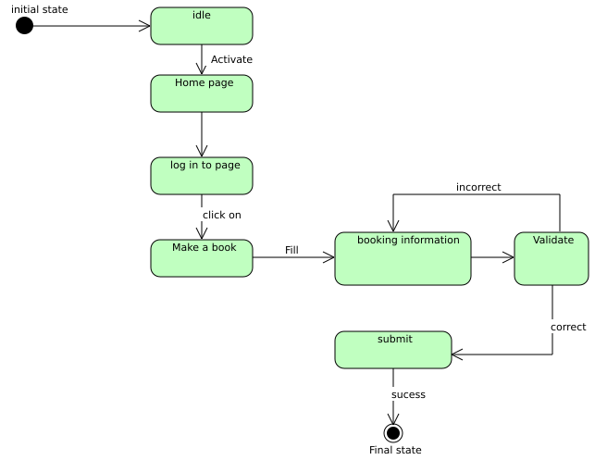
State chart diagram
state chart diagram for making a book
A state chart diagram is a view of a state machine that models the changing behavior of a state.
State chart diagrams show the various states that an object goes through, as well as the events that cause a transition from one state to another.
The common model elements that state chart diagrams contain are:
States
Start and end states
Transitions

Slide 22
System design
Purpose and goal of design
Security
Extensibility
Availability
Usability
Portability
Performance

Slide 23
Proposed software architecture

Slide 24
Component diagram shows how objects (classes) in our system are grouped together and form components.
The components interact with each other either in giving service to other components or requesting service from other component.
Component Diagram for Admin Functionality

Slide 25
Deployment diagram
Deployment diagram is a static view of the run-time configuration of hardware nodes and the software components that run on those nodes. It shows the hardware of system, the software that is installed on that hardware.

Slide 26
Persistent model
Mapping

Slide 27
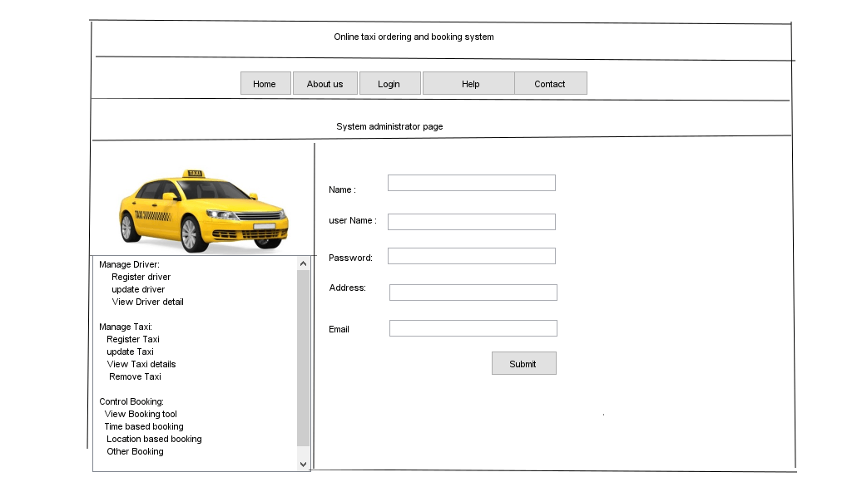
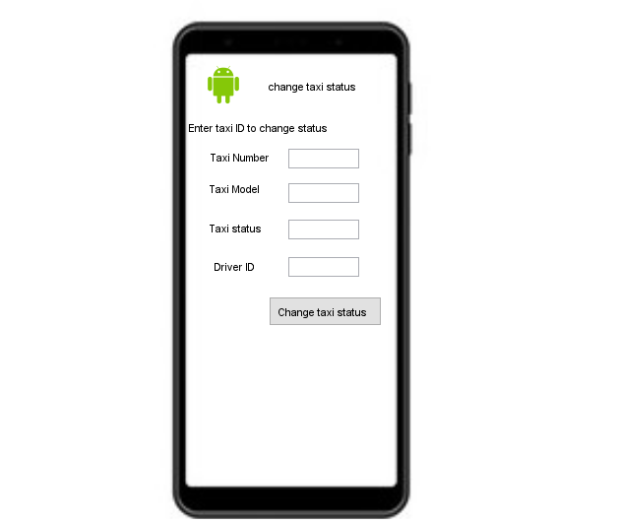
User interface design

Slide 28
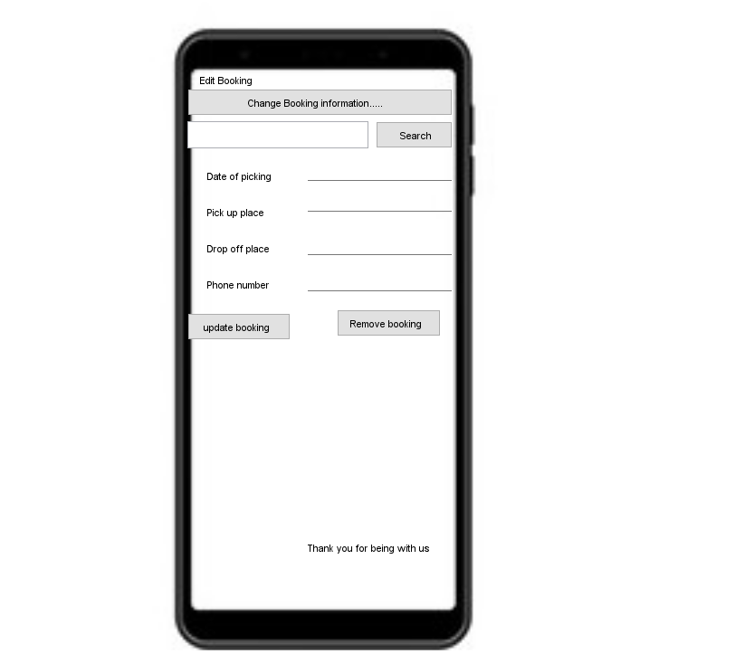
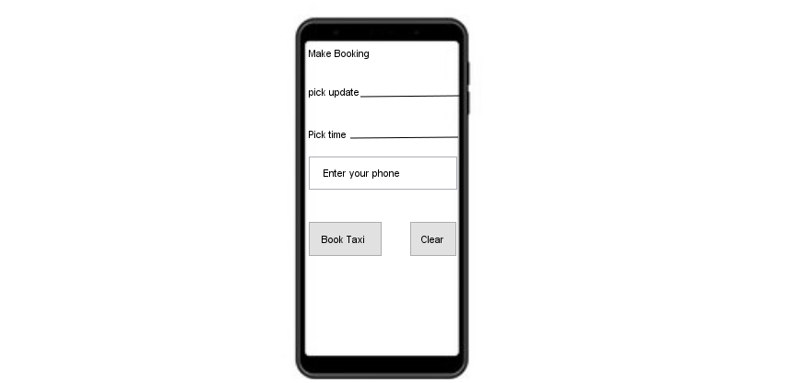
User interface cont’d

Slide 29
Access control and security
In the system, different actors have access to different functionality and data. The system has different users such as passengers, administrator and driver.
The passengers: Represents unauthenticated user. It is used by without Login subsystems to book taxi. And also they responsible to fill booking form, select, search booking.
Driver: Is an authenticated user who is responsible to accept and reject booking, change taxi current status and cancel booking.
Administrator: Is an authenticated user. It is used by login subsystem. He or she is responsible for managing drivers, taxi and control booking.

Slide 30
Thank you

